Slide 1
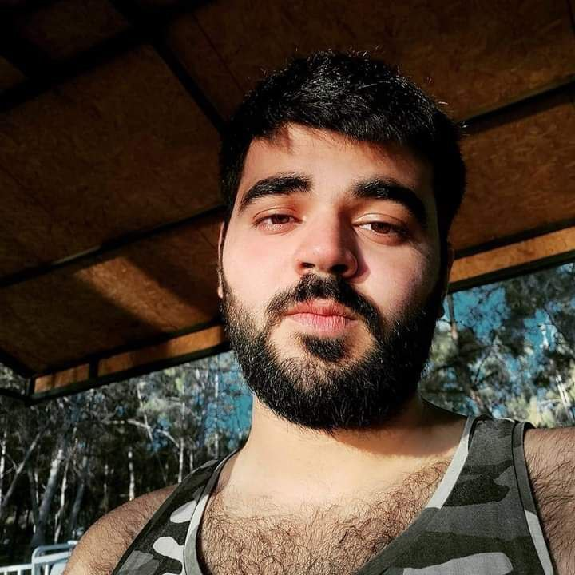
«Ibrahim Abdo»
«231018»
«Project 1A , FAI1»
[photo]
Learning Log
«academicyear» «academicblock»
Design by Marvin Damstra

Slide 2
How To Use
This Template
As a student at Breda University of Applied Sciences studying to become a professional, you are required to provide evidence that demonstrates your professional learning and growth during the block. This template is intended to provide you with a well-structured and organised format for doing this effectively. Keep in mind that certain competencies may require you to update your evidence every week, and others may have only be relevant during a particular week or two.
With the evidence you present here teachers should get a clear and comprehensive overview of your progress, how you’ve engaged with feedback, as well as your general attitude and performance as a student and as an aspiring data professional.
Note that number and size of text boxes and how they are organized on each slide may be modified as needed. It is up to you to decide what layout is most effective for the content you are providing. You may also add slides if needed, but try to be as economical as possible, i.e. quality over quantity. Focus on the things that are the most significant and meaningful.
You are also free to stylise this template to improve the graphic design and visual appeal, but please remember its purpose: to provide evidence of your progress towards becoming a professional developer. Changes should only enhance and extend the information, and may never subtract. I.e. do not delete anything or change the order of things. If in doubt, seek approval from your teachers!

Slide 3
Section A
NOT IN BLOCK A – IGNORE THIS SLIDE
A
Goal Setting
Notes:
MUST BE UPDATED EVERY WEEK
This is simply a log (journal) of what you do each day, and what you learn from it. It is your responsibility to update this regularly and frequently. Be sure to include working links to any specific evidence you are referencing (and make sure that you share your docs with the teaching team). Note: some of the required information may be captured in production documents such as your work log or peer reviews.
In such cases, you simply need to provide links to those artifacts and may include any explanatory comment or reflection you feel is appropriate.
(Some reflection is almost always a good idea as it provides the foundation for Section C.)

Slide 4
Section B
B
Progress Log
Notes:
MUST BE UPDATED EVERY WEEK
This is simply a log (journal) of what you do each day, and what you learn from it. It is your responsibility to update this regularly and frequently. Be sure to include working links to any specific evidence you are referencing (and make sure that you share your docs with the teaching team).
Note: some of the required information may be captured in production documents such as your work log or peer reviews. In such cases, you simply need to provide links to those artifacts and may include any explanatory comment or reflection you feel is appropriate.
(Some reflection is almost always a good idea as it provides the foundation for Section C.)

Slide 5
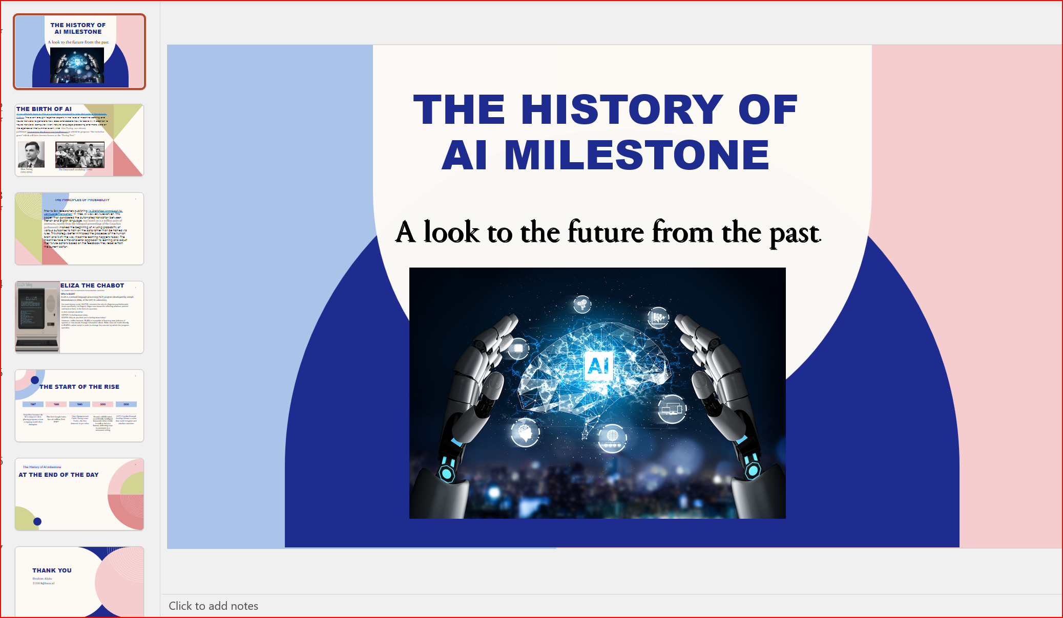
1
Week 1 - Log
1/2
What did you do?
Reflection
What goal(s) did you set for this week?
I set the goal of week (1) to get to know the lecturers and my colleagues, and at the same time to get more adaptive to the university system
What have you actually been able to do?
There is still another day to finish week(1) and we already did a lot we got to know more about DSAI and the future rule job Data scientist what skills and requirements he should have
We did 2 quizzes about the things we had, and we also delivered presentation with other students.
Showcase the evidence of your progress (production artifacts, short descriptions-links-pictures animated gifs, etc.)
How did the week go?
I faced some difficulties, but it went well as in general
What went well?
It went really good to know the university and my colleagues
What didn’t go so well?
I faced problems on Wednesday and Thursday as I had problems doing the assignments in how to install github and vscode etc….
What did you learn?
The main elemnt I had learned for now is to keep it up with bright space
And the assignments notification for next week , and I should be more aware of dealines and what should be done in precise
What could be added as an Action point looking forward to next week?
To keep up with bright space and what quizzes should we do.
Notes:
., .

Slide 6
1
Week 1 - Feedback
2/2
Team, individual, peer, workshop feedback
[Reviewer] Feedback.
●The feedback were about how good the working log and learning were , but at the same time there were couple of issues , I need to write the headings of the tasks in working log to be more understandable which task I was doing and I need to write the task reflection or notes after I Finnish the task and my evidence need to be on git-hub to get easier access and prevent any harm to my evaluation , and I need to be ,more organized in my learning log from font to line order to give more concept to my file.
Response to Feedback:
I will make sure to keep on improving my working and learning log , and I really appreciate your help to teach me how to upload files on git-hub so I can use it for evidencing, and I start organize my learning log and keep updating my working log.

Slide 7
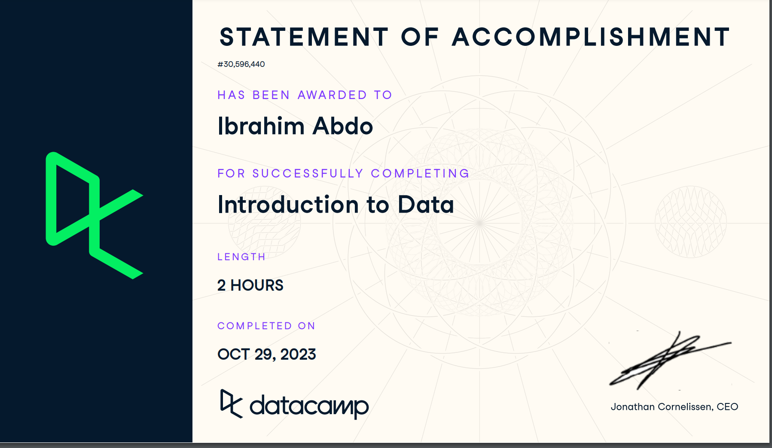
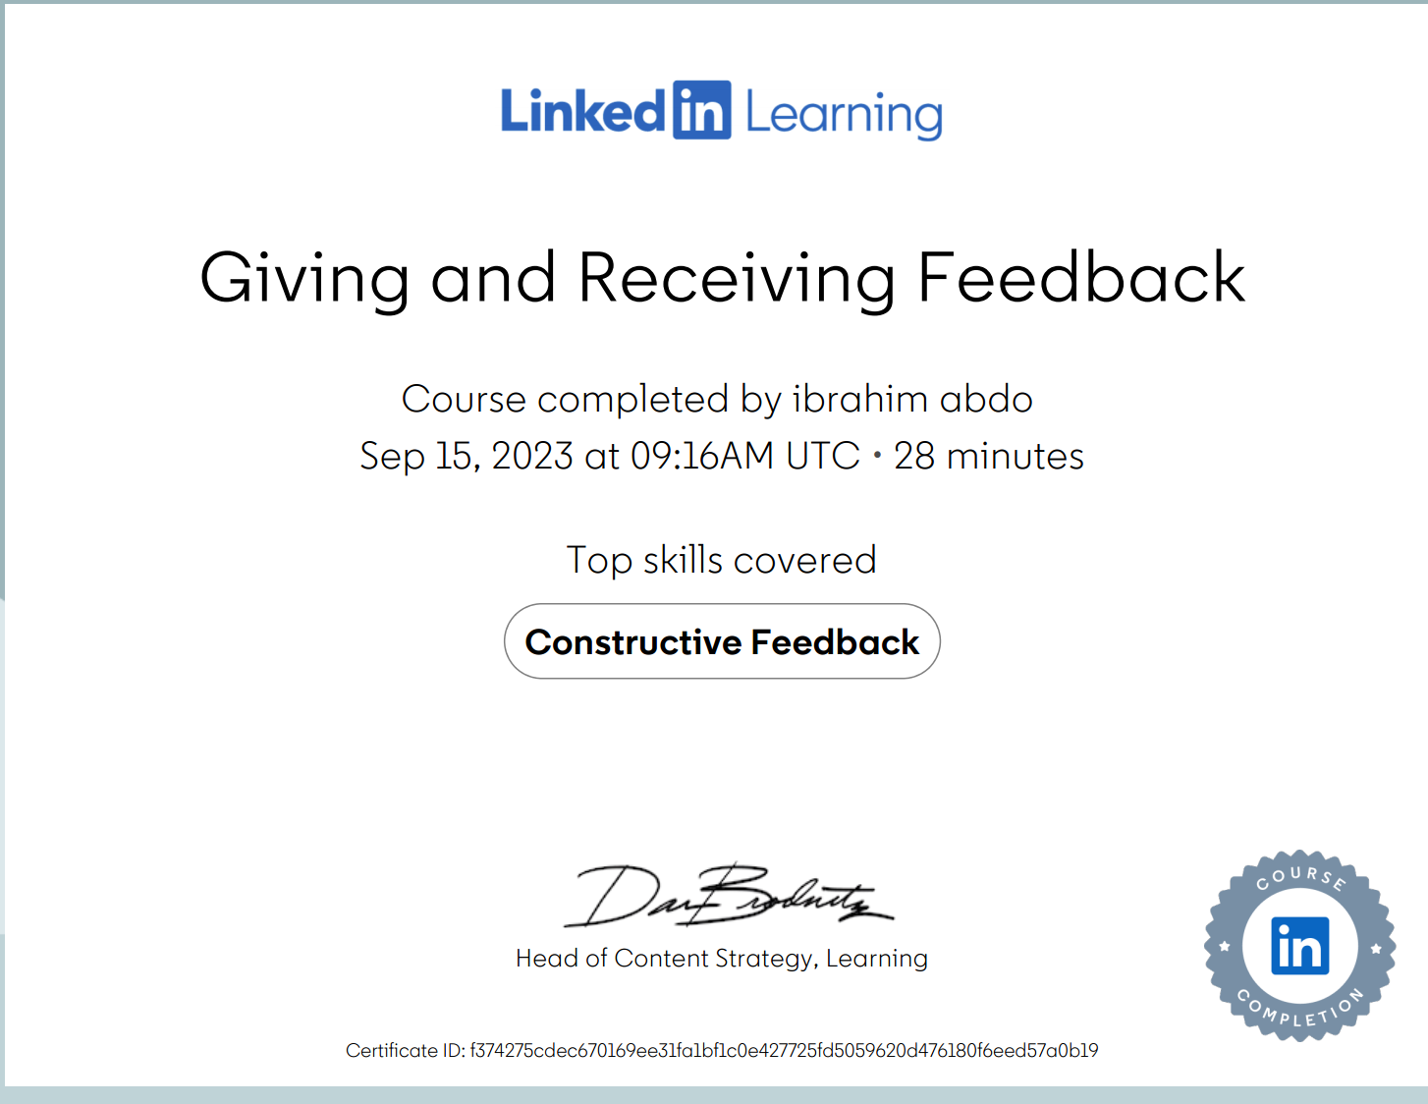
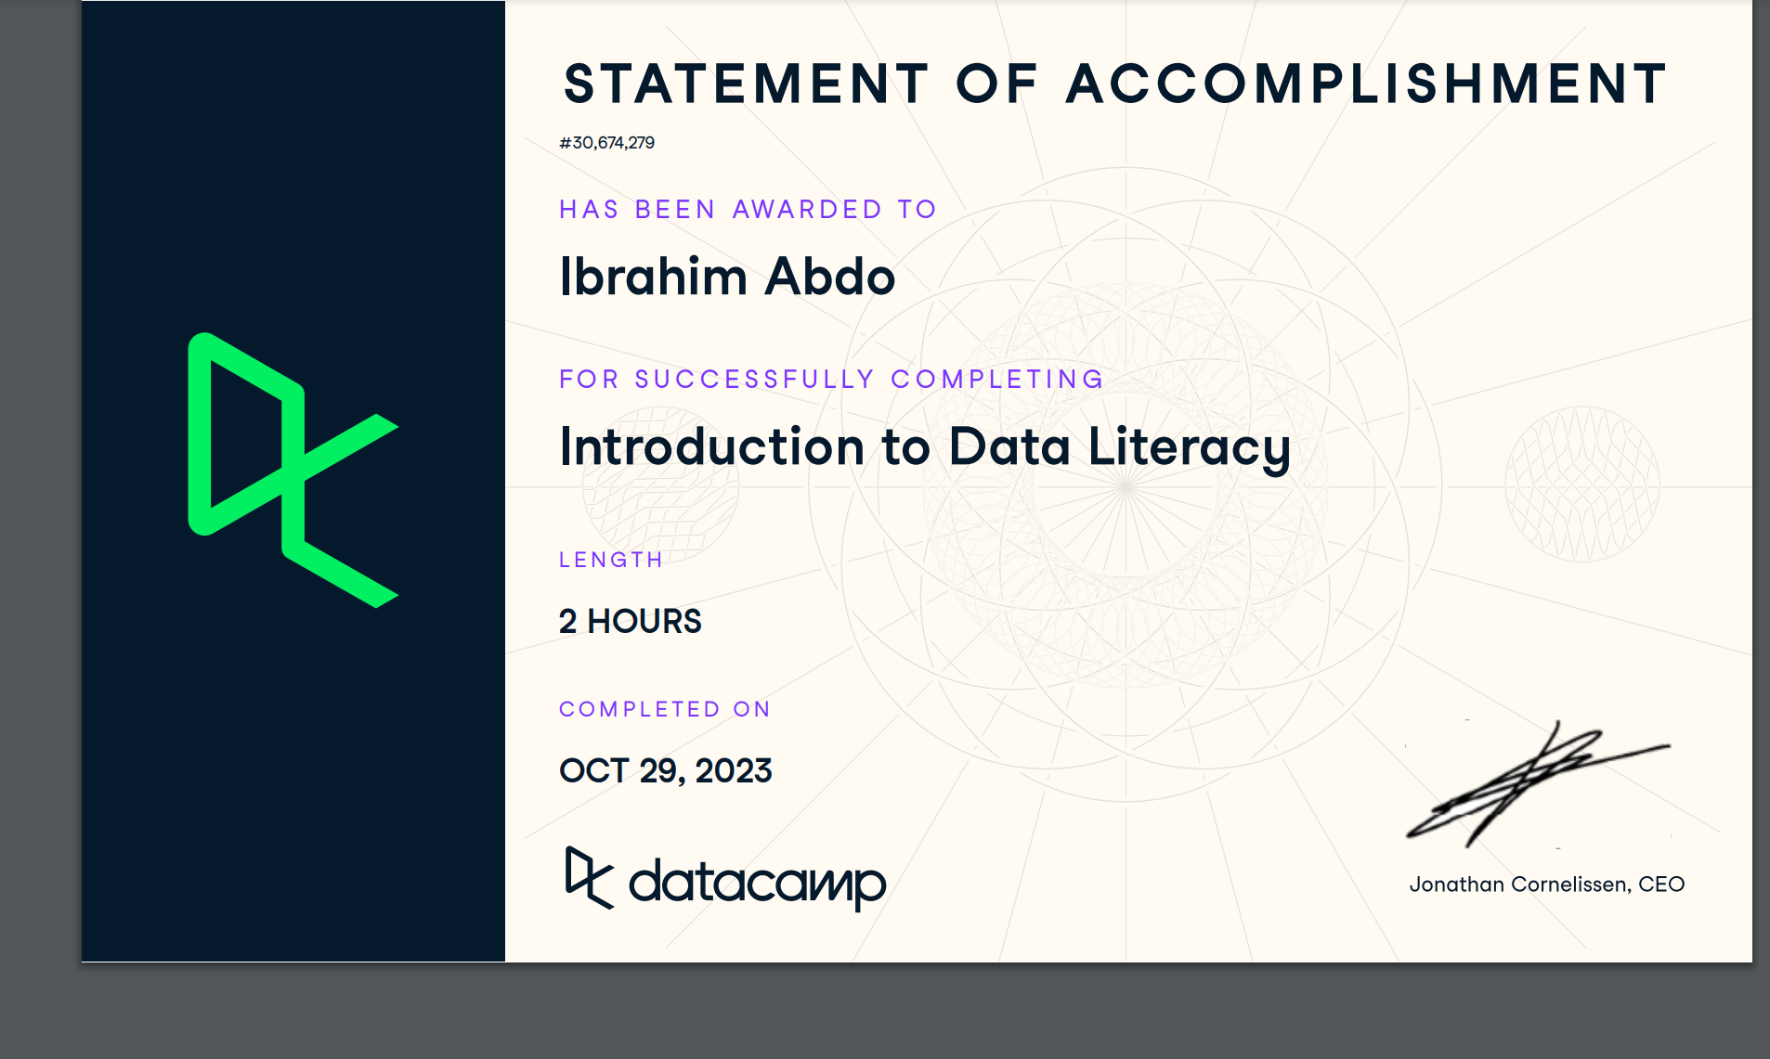
2
Week 2 - Log
1/2
What did you do?
Reflection
What goal(s) did you set for this week?
To keep the pace of the course and geeting more into dat camp courses.
What have you actually been able to do?
I was able to discover some interesting roles in the AI field such data scientist and analytics translator.
And the DIKW pyramid it explains how the data is being processed .
And the analytical steps to solve a problem in four steps : descriptive , Diagnostic , predictive , Prescriptive analytically
Showcase the evidence of your progress (production artifacts, short descriptions-links-pictures animat ed gifs, etc.)
How did the week go?
except that I’m behind in python coding
For now it’s going good as we are going to get a review from the lecturer on our learning and working log , so we can have a better look on our work
What went well?
Organising the homework and the self-study material and time spending on doing tasks.
What didn’t go so well? I had to spend more time on python programming as it was a complex functions
What did you learn?
I learned the use of functions and loops of python and the DIKW pyramid and how to add context to the data to be informations and later to use it as knowledge and do decisions in wisdom.
What could be added as an Action point looking forward to next week?
To prepare data lab tasks as we have a presentation to do on Friday and to work more time on python in codingbat

Slide 8
2
Week 2 - Feedback
2/2
Team, individual, peer, workshop feedback
[Reviewer] Feedback
●The feedback were about how good the working log and learning were , but at the same time there were couple of issues , I need to write the headings of the tasks in working log to be more understandable which task I was doing and I need to write the task reflection or notes after I Finnish the task and my evidence need to be on git-hub to get easier access and prevent any harm to my evaluation , and I need to be ,more organized in my learning log from font to line order to give more concept to my file.
Response
I will make sure to keep on improving my working and learning log , and I really appreciate your help to teach me how to upload files on git-hub so I can use it for evidencing, and I start organize my learning log and keep updating my working log.

Slide 9
3
Week 3 - Log
1/2
What did you do?
Reflection
What goal(s) did you set for this week?
To get to know more about the domains and subdomains of AI.
To finalize the presentation about the science fiction movie “minority report.
To know more about the role of a data engineer
To get to know more about the ethics of AI
What have you actually been able to do?
I was able to get to know the life of a data scientist when I got the chance to get a lecture by john artherfold.
I got the chance to study an ethical case of denial of financial situation of a couple called fred and tamara .
We did at the block project about the doing a presentation that enquires
All the information we had learned we were able to show it.
Showcase the evidence of your progress (production artifacts, short descriptions-links-pictures animated gifs, etc.)
Evidence link 1.
Evidence link 2
Evidence link 3
Evidence link4
How did the week go?
It was good in overall and bit of challenging.
What went well?
The organizing of the self-study materials and connecting more with my peers
Having a feed back turns out not to be a bad thing after all as I got the chance to develop myself more and erase my mistake from happening again
What didn’t go so well?
Time management as there was a lot to do especially with a presentation on the table so I had to delay the coding materials to another day so I can focus more on the presentation
What did you learn?
I managed to use git-hub to upload my files in evidencing
I made good use from mentor advice on how to improve my logs and it’s going in the right direction
I also learned to evidence and document everything we are working on to prove it on later
What could be added as an Action point looking forward to next week?
To make good manage of time given and prevent interaction of tasks between eachother and not waste time during data-lab .

Slide 10
3
Week 3 - Feedback
2/2
Team, individual, peer, workshop feedback
[Reviewer] Feedback
It seemed I’m doing well in the working and learning log so far but I need to mention the feedbacks on the other weeks as well , and he realized that I’m having difficulties with doing python applications on coding bat , we discussed this and we figured out that the main reason is my working environment as being at home don’t make me do so much progress , because of all of the distracting's that it’s there .
Response
I will write the feedbacks on the weeks that wasn ‘t mentioned as well in my learning log , and I will find a focusing space to do the tasks from python , like the library next to me or even coming to the campus to make myself more productive , as I need to work more on my python files and my coding bat , I will try to catch up with my colleagues by the end of the autumn break.

Slide 11
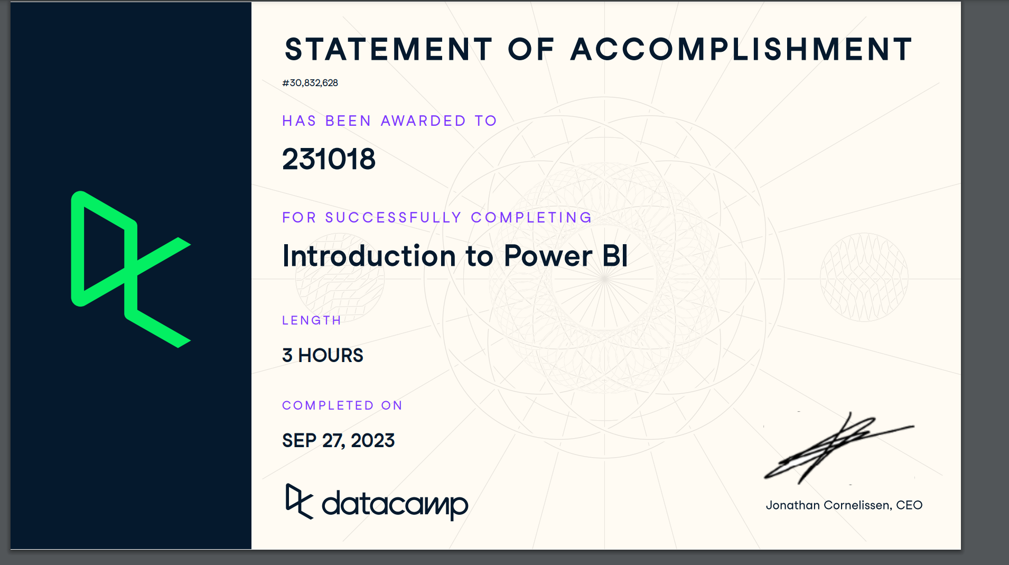
4
Week 4 - Log
1/2
What did you do?
Reflection
What goal(s) did you set for this week?
To be familiar in using Power Bi
Getting to know more about SDG and it goals
To practice python more often as I’m delayed on track
What have you actually been able to do?
To use power bi and applying filtering and cleaning to the data
To make a data-driven question research
Showcase the evidence of your progress (production artifacts, short descriptions-links-pictures animated gifs, etc.)
2023-24a-fai1-adsai-Ibrahimabdo231018/certificates/Introduction to Power BI.pdf at main · BredaUniversityADSAI/2023-24a-fai1-adsai-Ibrahimabdo231018 (github.com)
How did the week go?
It went well overall with some challenges
What went well?
Practicing power bi smoothly
What didn’t go so well?
Just on Friday forgot to scan mi student id for attendance
What did you learn?
Power bi and how to collect dat
What could be added as an Action point looking forward to next week?
Finnishing things a bit faster.

Slide 12
4
Week 4 - Feedback
2/2
Team, individual, peer, workshop feedback
[Reviewer] Feedback
It seemed I’m doing well in the working and learning log so far but I need to mention the feedbacks on the other weeks as well , and he realized that I’m having difficulties with doing python applications on coding bat , we discussed this and we figured out that the main reason is my working environment as being at home don’t make me do so much progress , because of all of the distracting's that it’s there
Response
I will write the feedbacks on the weeks that wasn ‘t mentioned as well in my learning log , and I will find a focusing space to do the tasks from python , like the library next to me or even coming to the campus to make myself more productive , as I need to work more on my python files and my coding bat , I will try to catch up with my colleagues by the end of the autumn break.

Slide 13
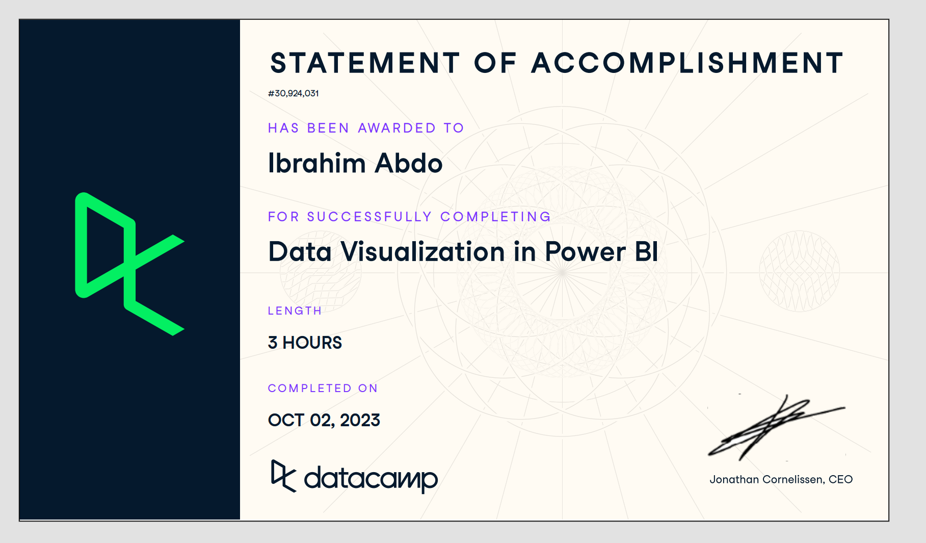
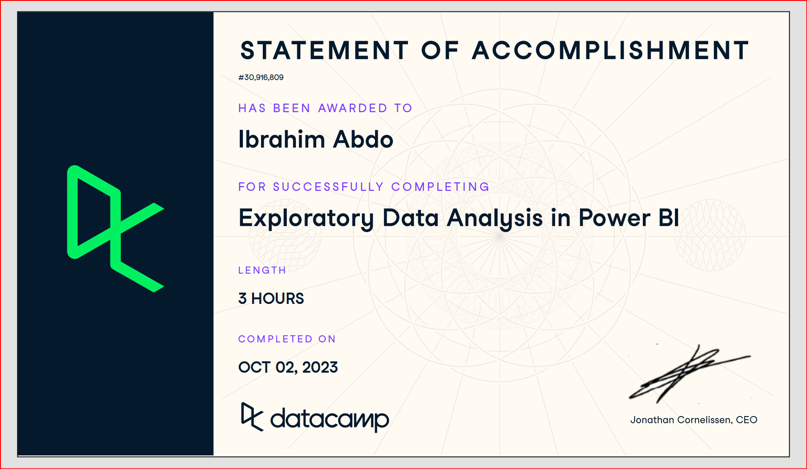
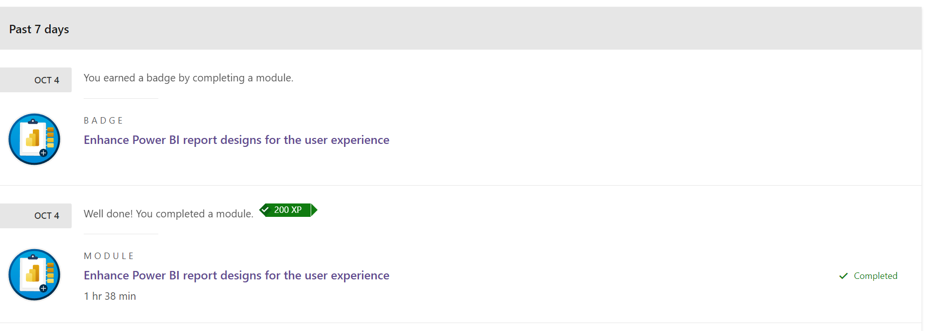
5
Week 5 - Log
1/2
What did you do?
Reflection
What goal(s) did you set for this week?
To work on my power bi project
To collect data set
To do more in python
What have you actually been able to do?
To finishing courses that is related to power bi
Doing research about data sets
Knowing how to make visualization
Showcase the evidence of your progress (production artifacts, short descriptions-links-pictures animated gifs, etc.)
How did the week go?
It went a little bit good it could been better
What went well?
Using power bi it was smooth to handle
What didn’t go so well?
Collecting data sets it is the most difficult operation
What did you learn?
How to explore and clean data and how to make good visualization
What could be added as an Action point looking forward to next week?
Being better in collecting data
More comprehensive in doing python and coding bat

Slide 14
5
Week 5 - Feedback
2/2
Team, individual, peer, workshop feedback
[Reviewer] Feedback
Response

Slide 15
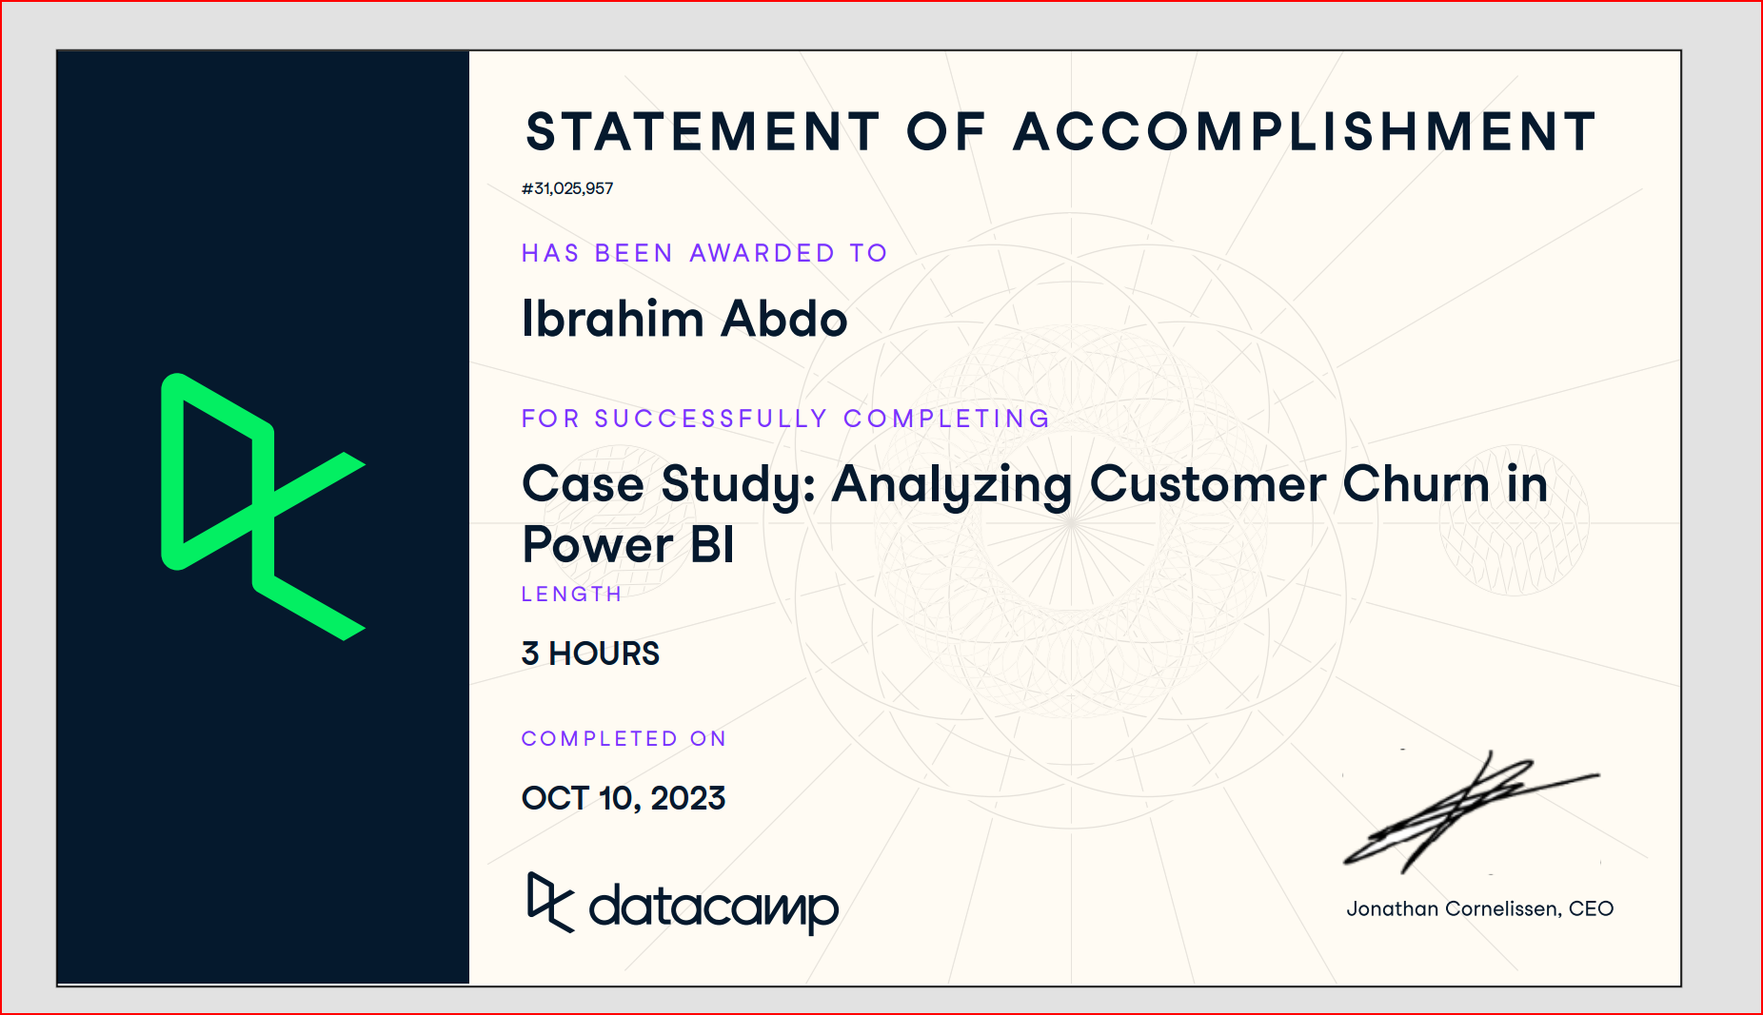
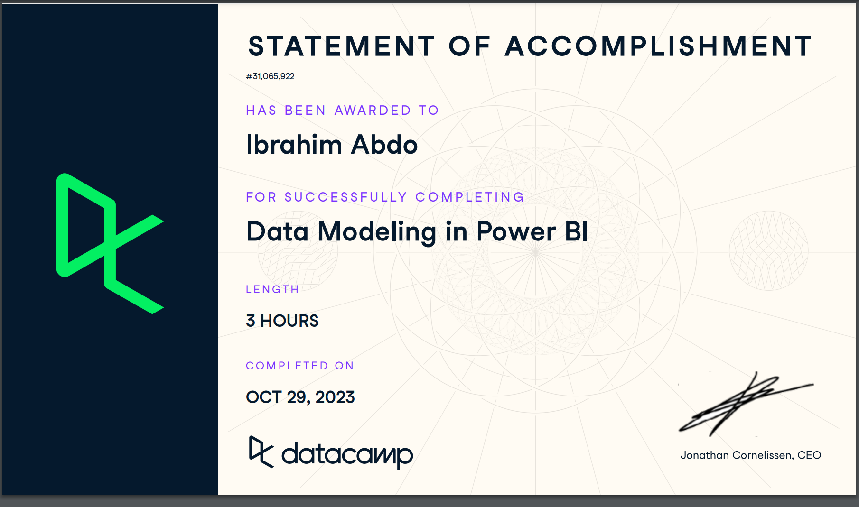
6
Week 6 - Log
1/2
What did you do?
Reflection
What goal(s) did you set for this week?
To finish the dashboard
Start organize my data
Planning for the new challenge
What have you actually been able to do?
I finnished the case study : analyzing customer churn in power bi
Showcase the evidence of your progress (production artifacts, short descriptions-links-pictures animated gifs, etc.)
How did the week go?
It went well overall
No absents always on time
What went well?
Keeping up on datacamp
Earning more skills on power bi
What didn’t go so well?
Organizing the dashboard
Creating enough visualizations
What did you learn?
Making a correlation coefficient
How to preform a linear regression
What could be added as an Action point looking forward to next week?

Slide 16
6
Week 6 - Feedback
2/2
Team, individual, peer, workshop feedback
[Reviewer] Feedback
Response

Slide 17
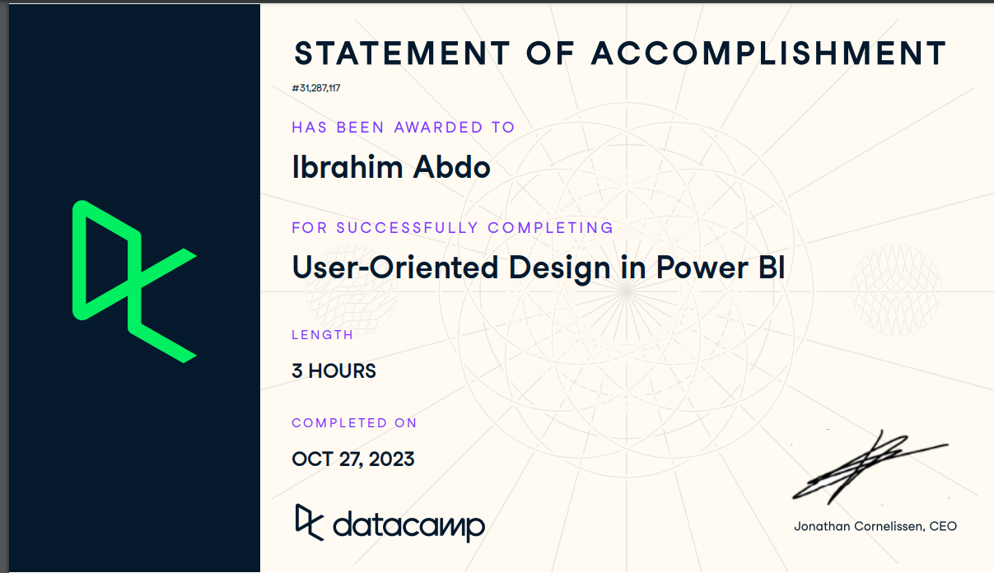
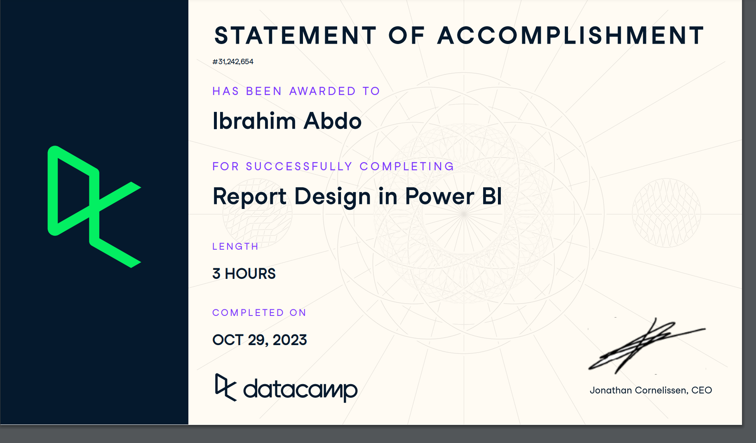
7
Week 7 - Log
1/2
What did you do?
Reflection
What goal(s) did you set for this week?
To finish the dashboard
To know about the user_oriented experience
To know about reporting in power bi
What have you actually been able to do?
Finish data camp courses
To learn more about power bi editing query
Showcase the evidence of your progress (production artifacts, short descriptions-links-pictures animated gifs, etc.)
How did the week go?
The going was going well as most of the tasks and deliverables
Started to become more clear
What went well?
Giving and recieving feedback from other peers
So we can adjust our power bi dashboard
What didn’t go so well?
It seems that the learning and working log need it more things to add
What did you learn?
How to organize all the files and it will be easier in Block B after we get used to the system
What could be added as an Action point looking forward to next week?
Finalizing all the deliverables

Slide 18
7
Week 7 - Feedback
2/2
Team, individual, peer, workshop feedback
[Reviewer] Feedback
Response

Slide 19
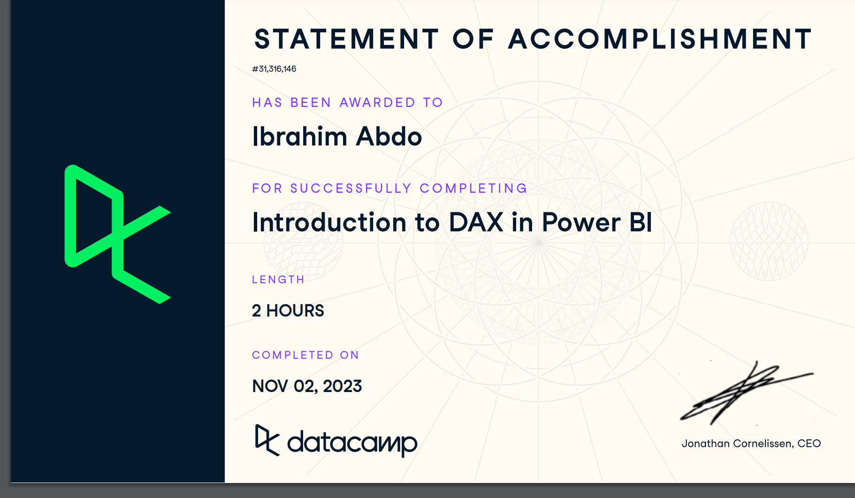
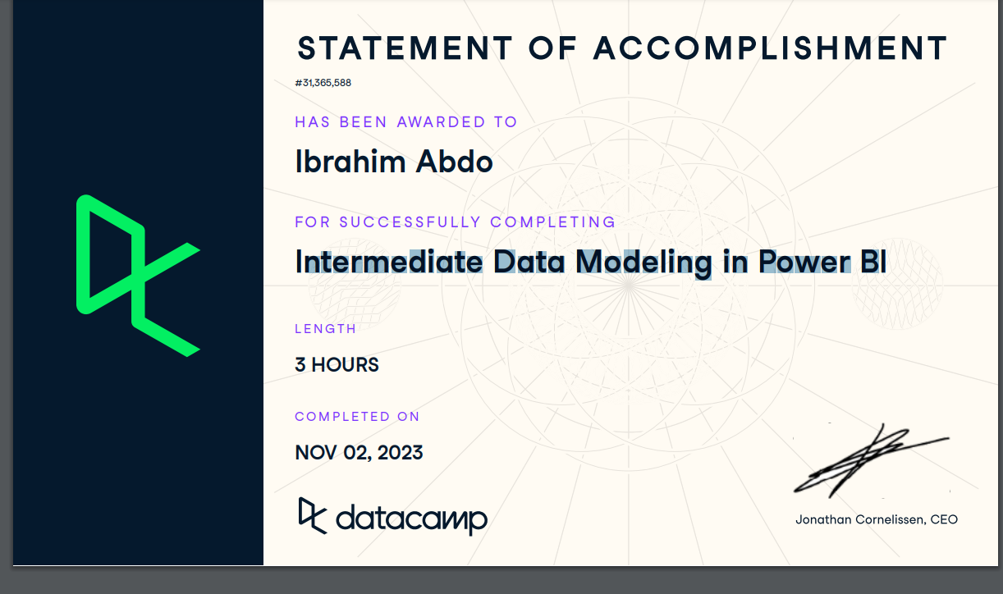
8
Week 8 - Log
1/2
What did you do?
Reflection
What goal(s) did you set for this week?
To Evidence all my work
To finish all my left tasks
To collect the final feedbacks from other peers
Putting the final touches on the dashboard
Finalizing my Working and Learning Log
Finalizing my Dashboards
To deliever the dashboard
To finish the codingbat
What have you actually been able to do?
I was able to organize my files on my GitHub
I was able to evidence my work and upload the required links
Finishing my Working and Learning Log
Receiving constructive feedback from my peers
Showcase the evidence of your progress (production artifacts, short descriptions-links-pictures animated gifs, etc.)
2023-24a-fai1-adsai-Ibrahimabdo231018/Feedbacks/pre-powerbi-final presentaion/3d9a0962-4ee6-4186-a868-7aabb57a1043.pdf at main · BredaUniversityADSAI/2023-24a-fai1-adsai-Ibrahimabdo231018 (github.com)
How did the week go?
It was a bit intensive as we had to make sure everthing is in the correct order
And challenging at the same time as we had to finish the Dashboards
What went well?
Finishing the Dashboard
And getting some positive feedback
Having good understanding on the final task
What didn’t go so well?
That we didn’t get piece of frank peters cake (: joking
Everything went well
What did you learn?
How to make linear regression and correlation coefficient
What could be added as an Action point looking forward to next week?
Be more prepared from the start and not procrastnate stuff.

Slide 20
8
Week 8 - Feedback
2/2
Team, individual, peer, workshop feedback
[Reviewer] Feedback
Response

Slide 21
Section C
C
Progress
Intended Learning Outcomes
Notes:
MUST BE COMPLETED IN WEEK 8, BUT SHOULD BE UPDATED REGULARLY
This is where you link your evidence to each of the Intended Learning Outcomes of this block.

Slide 22
ILO 1
1
Professional Practice
The student demonstrates professional behavior as well as accountability and ethics in the application of industry best practices for planning, communication, collaboration, and responsible execution of work assignments.

Slide 23
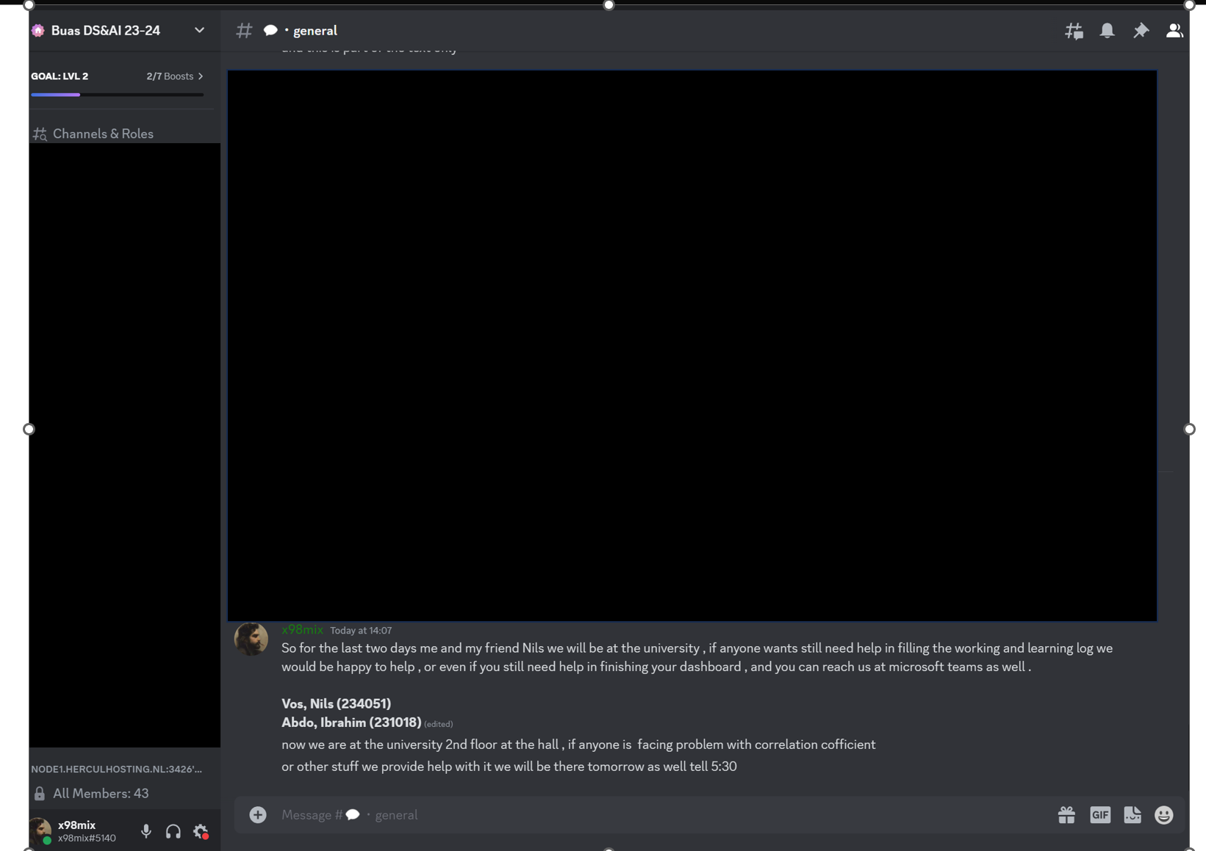
ILO 1
Professional Practice
The student demonstrates professional behavior as well as accountability and ethics in the application of industry best practices for planning, communication, collaboration, and responsible execution of work assignments.
1/1
1.3
The student attends the Datalab sessions, and submits work, adhering to defined guidelines and processes in the Creative Brief.
[Poor]:
I was able to notify the teaching staff if I were absent or late during Data Lab by filling in the ‘Data Lab Absent form’
which it was only one late due to a family condition, so it was less than the maximum two unexcused Data Lab absences during the block, as tracked by the ADSAI Attendance application.
[Insufficient]:
I was able to complete the Data Lab preparation exercises listed on Brightspace before the corresponding Data Lab
Session ; and I was able to keep updating the Working Log regularly. And meeting all the criteria in Poor.
[Sufficient]:
I was updating the Working Log on a daily basis; In case of absence (which didn’t happen) I was capable of completing the activities that are acceptable alternatives to the Learning activities presented in Data Lab. And
Meeting all the criteria in Insufficient.
[Good]:
I was able to submit a work that meets a professional standards regarding grammar , spelling , writing style, content , and neatness. And meeting all criteria in Sufficient.
[Excellent]:
I was able to share knowledge with or helping peers or other members of the AI/Data science community (posting a helping thread ) to give some help to the other. And meeting all criteria in Good.
Evidencing :
Link to evidence.
Helping peers.
Tasks link
Link to working log .
This is a screenshot from a platform called Discord that all the DSAI students uses to communicate with each other and me and my friend Nils we published a Blog post to provide help to other peers .

Slide 24
ILO 2
2
Professional Practice / Attitude
The student demonstrate self-exploration and personal development, good academic practices in learning how to learn and the acquisition of professional knowledge through research, study, analysis, applied practice, discussion and reporting.

Slide 25
ILO 2
Professional Practice
The student demonstrate self-exploration and personal development, good academic practices in learning how to learn and the acquisition of professional knowledge through research, study, analysis, applied practice, discussion and reporting.
1/1
2.4
The student reports on learning progress and updates plans in a well-written, concise format with appropriate visual communication, guided by active engagement with feedback.
[Poor]:
I was able to complete the Learning Log without any evidence of plagiarism .
[Insufficient]:
Each week the Learning Log details important tasks completed And meeting all criteria in Poor.
[Sufficient]:
Each week the Learning Log details what was learnt. Each of the ILOs in the Learning Log details how they were addressed. And meeting all criteria in Insufficient.
[Good]:
All references to important resources used are included .My evidence is clear and to the point . And meeting all the criteria in Sufficient.
[Excellent]:
My writing style is professional and free of spelling mistakes. Clear what was done and why individual and project feedback was given .And meeting all criteria in Good.
Evidencing:
Learning log.

Slide 26
ILO 3
3
Introduction to Artificial Intelligence
The student is able to identify, and analyze AI applications in fictional and real-life (business) scenarios by examining and applying relevant concepts from AI literature and theory.

Slide 27
ILO 3
Introduction to Artificial Intelligence
The student is able to identify, and analyze AI applications in fictional and real-life (business) scenarios by examining and applying relevant concepts from AI literature and theory.
1/1
3.1
The student is able to identify, and analyze AI applications in fictional and real-life (business) scenarios by examining and applying relevant concepts from AI literature and theory.
[Poor]:
I was able to reach the poor criteria as I was able to communicate and talk
About my presentation for 06:39 minute which approximate to 7 minutes.
[Insufficient]:
I was able To identify and describe an AI topic from the movie minority report you can see this from minute “00:23” to “01:10” and I was able to mention the domain and subdomains that are Related to the AI topic in minute “04:39” to “05:19” and also meeting the Poor criteria
[Sufficient]:
and I Was also able to mention a real-life business related to the chosen AI topic
example in minute “03:41”to “04:37” , and the references were mentioned in minute
“06:33” till the end of the video , and meeting the Insufficient criteria
[Good]:
I was able to evaluate the technical feasibility
of the AI topic in minute “02:32”to “03:40” , and mentioning a scholarly resource at the end, and meeting the Sufficient criteria .
[Excellent]:
I was able to talk about potential ethical and/or legal consequences of implementing the
chosen AI topic in a real-life (business) setting and it was mentioned in minute “05:13”
Till the minute “06:32” . With also meeting the Good criteria .
Evidencing:
Link to presentation
Link to the slides. I did a retake to add scholar resources.

Slide 28
ILO 4
4
Introduction to Data Science
The student demonstrates basic knowledge and skills in the field of data science by transforming a business requirement into a data science problem and propose an effective solution.

Slide 29
ILO 4
Data Science
The student demonstrates basic knowledge and skills in the field of data science by transforming a business requirement into a data science problem and propose an effective solution.
1/2
4.1
The student is able to design an effective dashboard in Power BI in order to provide new insights into a research question.
[Poor]:
I was able to describe data using measure of central tendency such as mean(Average) and to determine which measure is best applicable to solve a use-case using Power Bi.
[Insufficient]:
I was able to create appropriate data visualizations , according to the criteria in Data Lab task 5 , and determine which visual is best applicable to solve a use-case using Power Bi.
[Sufficient]:
I was able to calculate and interpret measures of association such as a correlation coefficient to solve a use-case using Power Bi.
[Good]:
I was able to incorporate data-driven storytelling techniques and user experience(UX) design principles ; according to the criteria in Data Lab task 7 , to create an intuitive and clearly comphrensible Dashboard . And meeting all criteria in Sufficient
[Excellent]:
I was able to recognize the data science lifecycle as an iterative process and can clearly distinguish between phases of CRISP-DM. And meeting all criteria in Good
Evidencing:
Evidence Link.
Evidence Link pre-dashboard.
Evidence pre-dahsboard2.

Slide 30
ILO 4
Data Science
The student demonstrates basic knowledge and skills in the field of data science by transforming a business requirement into a data science problem and propose an effective solution.
2/2
4.2
The student applies the data science concepts learned and use a standard data science tool to solve a project task.
[Poor]:
I was able to compose a clear data-driven research question , according to the criteria in Data Lab task 2 , and I was able to import data in ‘flat-file’ format to Power Bi.
[Insufficient]:
I was able to select , clean and transform an appropriate dataset to answer the data-driven research question according to the criteria in Data Lab task 3. And meeting all criteria in Poor.
[Sufficient]:
I was able to propose a solution ; a simple/multiple linear regression , to the data-driven research question based on the exploratory data analysis and visualizations using Power Bi. And meeting all criteria in Insufficient.
[Good]:
I was able to interpret mine findings correctly . And meeting all criteria in Sufficient.
[Excellent]:
I was able to discover new patterns in the dataset which are not related to the original research question and thereby , propose next steps for future research . And meeting all criteria in Good.
Evidencing:
Evidence link.

Slide 31
ILO 5
5
Introduction to Programming with Python
The student is able to write Python programs, to solve a wide range of introductory programming challenges and perform basic data analysis, using fundamental programming concepts.

Slide 32
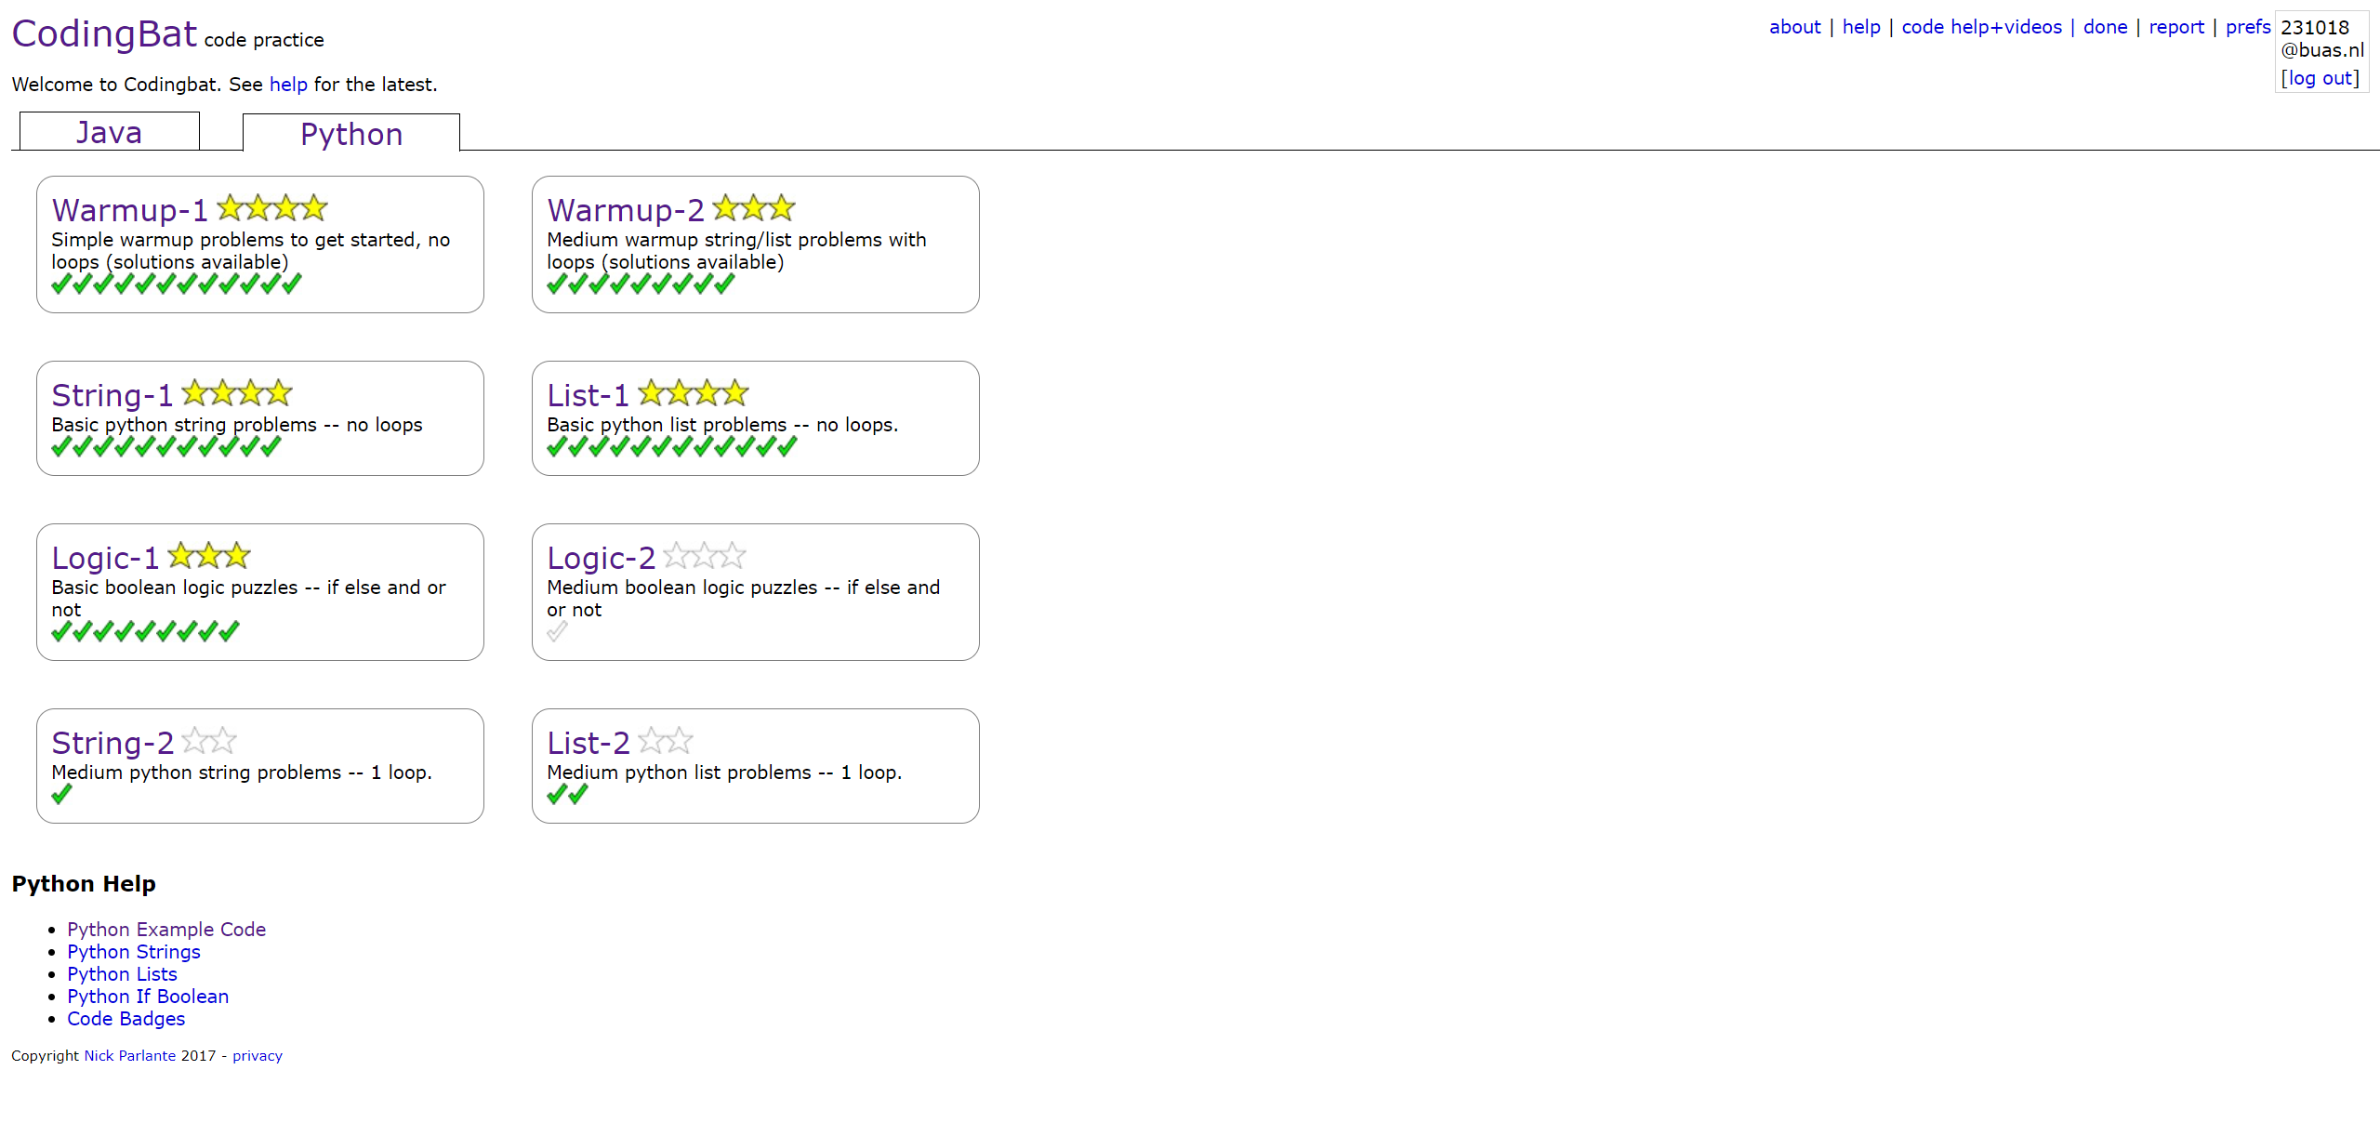
ILO 5
Introduction to Programming with Python
The student is able to write Python programs, to solve a wide range of introductory programming challenges and perform basic data analysis, using fundamental programming concepts.
1/1
5.1
The student is able to write Python programs, to solve a wide range of introductory programming challenges and perform basic data analysis, using fundamental programming concepts.
[Poor]:
I was able to write functions that use a wide range of conditional executions, evidenced by Data Lab Task 8
[Insufficient]:
I was able to write functions that use strings and lists to solve a wide range of problems evidenced by Data Lab Task 8 and meeting all criteria in Poor.
[Sufficient]:
I was able to convert a wide range of simple algorithms given in English into Python, evidenced by Data Lab Task 8 , and meeting all criteria in Insufficient .
[Good]:
Criteria not met.
[Excellent]:
Criteria not met.
Evidencing:
Link to coding bat progress.

Slide 33

Medal Challenges
Going the extra mile!

Slide 34
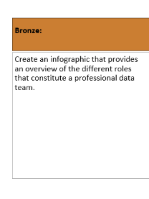
Medal Challenges
Going the extra mile!
1/1
Put your evidence down here to receive a medal!
[Bronze medal challenge]:
Link to bronze challenge.
[silver medal challenge]
Evidence link.

Slide 35
Section D
D
Reflection
Notes:
MUST BE COMPLETED IN WEEK 8
Summative reflection on your progress during the block including a critical assessment of everything you did and learned during the block. This is a comprehensive review of everything recorded in Section B, evaluated against the goals and planning laid out in Section A.

Slide 36
D
What did I achieve this block?
1/2
My most significant achievements this block
Keeping up with the working log on a daily basis
Keeping up with the learning log on a daily basis
Trying to learn as much as possible from the Data Camp courses as stand in top 10 in the leaderboard
To be able to produce a power bi visualization with clear view
My most difficult challenges this block
For sure the python was the hardest as I’m not familiar with programing language
The most important lessons I learned
Not procrasting is the most valuable lesson I have learned for sure

Slide 37
D
How well am I progressing?
2/2
Reflection on my self assessment My self assessment grade is a
x.x
...
I think I graded myself a fair assessment but of course the mentor decides the best at the end
How I plan to improve next block
To start the planning early and to be one step a head so I don’t pressure myself at the end of the block
And for sure I will be having more outside courses for learning Python on my free time

